Slide 1
1/10
An Implementation for
Logistic Regression
Under the guidance of Prof. V. Milutinovic
Presenter - Jayendra Khandare
(jkhandar@umail.iu.edu)

Slide 2
2/10
Logistic Regression[1]
This is a regression model where the dependent variable (DV) is categorical.
This project covers the case of
a binary dependent variable
  where it can take only two values, "0" and "1",
which represent outcomes such as
  Pass / fail,
  Win / lose,
  Alive / dead
  Healthy / sick

Slide 3
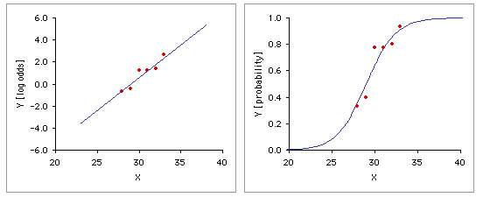
Methodology[2]
3/10
For given dataset of points(x,y)
  - Linear regression is performed. Equation of regression is found.
This equation predicts line which won’t give us binary output as
  - yes or no.
Hence, the logit( ) function is used to narrow the outputs.
This function converts the values between 0 and 1.
So in a way, this calculates the probability.
This probability is then converted to
  1 (if probability > 0.5)
  0 (if probability < 0.5)
Notes:
Incur an overhead/cost for this reconfigurability; but can make that back by efficient architecture (dataflow)

Slide 4

Methodology (details)
4/10
The output of linear regression performed on dataset includes :
  Y - Intercept of the line
  Slope of the line
logit ( ) uses the RHS of the equation.
  y = mx + c where m is slope and c is intercept
The probability is calculated.
This converts the linear function to sigmoid function.
For best fit, the technique used is
  Least squares method
  Which minimizes the error with a significant difference

Slide 5
Implementation
5/10
This code is based on two methodologies.
  Data-flow computing[3] and control-flow computing
Initially, random function[4] creates random data for y as 0s or 1s.
Then, x[ ] and y[ ] are passed to DFE( ) and CPU( ).
These methods first calculate mean,standard deviation and squares of deviations.
  DFE() uses dataflow technique for calculations.
  CPU() uses control flow model.
Based on this, linear equation is calculated using least squares method[5].
  Separately for both
Intercept and slope for the line are derived and passed to logit( ) function.
  Which converts the output as probabilities.
In this way, the linear form is changed to sigmoid(S – shaped) curve.
The comparison between outputs of CPU( ) and DFE( ) is done at the last and printed out.

Slide 6
How to run this Implementation
6/10
This implementation is created using WebIDE
  provided by Maxeler Technologies[6].
It uses ‘typecast template’ which already exists in WebIDE account.
Simply copy the CPUcode and EngineCode into respective files.
Change the value of SIZE and val in the CPUCode to the one you desire.
Delete all pre-existing .max configuration files[7] from :
  CPUCode/results
  RunRules/Simulation/maxfiles
Press ‘BUILD’ button which will compile the code and create graphs, and DFEs.
As this is checking simulation, you will get two results :
  First calculated without using dataflow techniques by CPU( ) method.
  Second calculated using dataflow techniques by DFE( ) method.
The output includes max score, consensus, profile matrices, and status.
Status indicates whether the answer from CPU( ) and DFE( ) are same or not.

Slide 7
What really happens in data-flow
7/10
During one unit of time called a tick,
the Kernel executes a step of computation,
consumes one input value, and
produces one output value.
This is done after creating appropriate graphs.
Hence, the speed is accelerated.

Slide 8
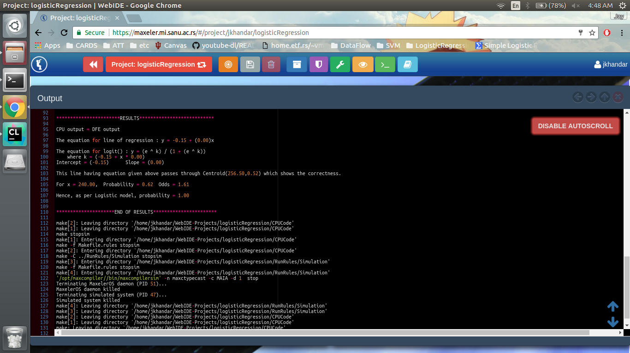
Snapshot of Output
8/10

Slide 9
References
9/10
Logistic Regression Page maintained by Wikipedia.org
  – https://en.wikipedia.org/wiki/Logistic_regression
Statistics 101 Video lecture series on youtube.com
  – by Brandon Foltz, M.Ed. - http:// www.bcfoltz.com/blog
Instructions provided by Prof. V. Milutinovic
  http://home.etf.rs/~vm/os/vlsi/predavanja/maxeler.html
srand() - standard function available in stdlib.h
Linear Regression
  - D. G. Simpson, Ph. D. [Prince George’s Community College, Maryland]
WebIDE provided by Maxeler Technologies(available: free for students )
  https://maxeler.mi.sanu.ac.rs/
A special thanks to Mr. Ognjen Andric for providing instructions to correct a bug found in WebIDE.
  oandric@maxeler.com

Slide 10
About Presenter
10/10
Jayendra Khandare
Graduate Student at School Of Informatics and Computing, Indiana University Bloomington
Created this implementation for :
  CSCI B649 DATAFLOW SUPERCOMPUTING
Course taken for 3 Credits
  under Prof. V. Milutinovic

